Slide 1




Slide 2

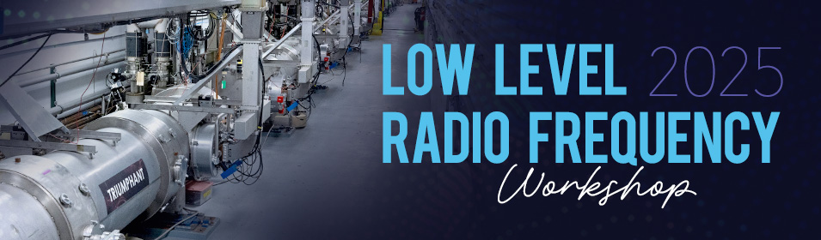




Development and Testing of a Low-Noise X-Band LLRF Prototype System
Phani Deep Meruga, Borut Baričevič, et al.
October ${16}^{th}$, 2025
Newport News, Virginia
Email: phanideep.meruga@i-tech.si
This project has received funding from the European Union‘s Horizon Europe research and innovation programme under grant agreement no. 101073480.

Slide 3
Outline:
EuPRAXIA Overview
RF stability challenges in LINAC‘s
X-Band LLRF Prototype Development
Analysis & Results
Conclusions & Outlook
LLRF-Workshop · Virginia, USA · October 15th, 2025
3

Slide 4
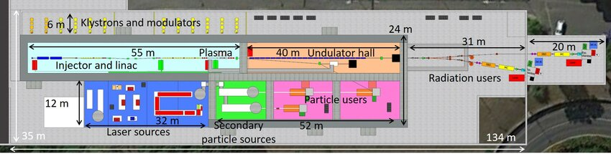
European Plasma Research Accelerators with eXcellence In Applications – EuPRAXIA (I)
EuPRAXIA aims to develop a compact, high-performance FEL facility based on X-band linacs and plasma accelerators.
Strong emphasis on ultra-short, high-brightness electron bunches
Pushes the limits of precision and timing control in RF and beam delivery
Development of accelerator technology at higher frequencies up to X-Band allows high accelerating gradients [MV/m] and shorter accelerating structures (compact machines).
Reference: EuPRAXIA SPARC LAB
LLRF-Workshop · Virginia, USA · October 15th, 2025
4

Slide 5
European Plasma Research Accelerators with eXcellence In Applications – EuPRAXIA (II)
Challenge of controlling RF parameters (amplitude and phase) at high frequencies and for very short pulses (~ 100ns).
LLRF system stability influenced by temperature drifts from RF systems at higher frequencies.
Development an X-Band LLRF prototype system in the the context of EuPRAXIA-DN.
Validation at TEX facility, INFN-LNF and finally, industrialization of the prototype.
Reference: EuPRAXIA SPARC LAB
LLRF-Workshop · Virginia, USA · October 15th, 2025
5

Slide 6
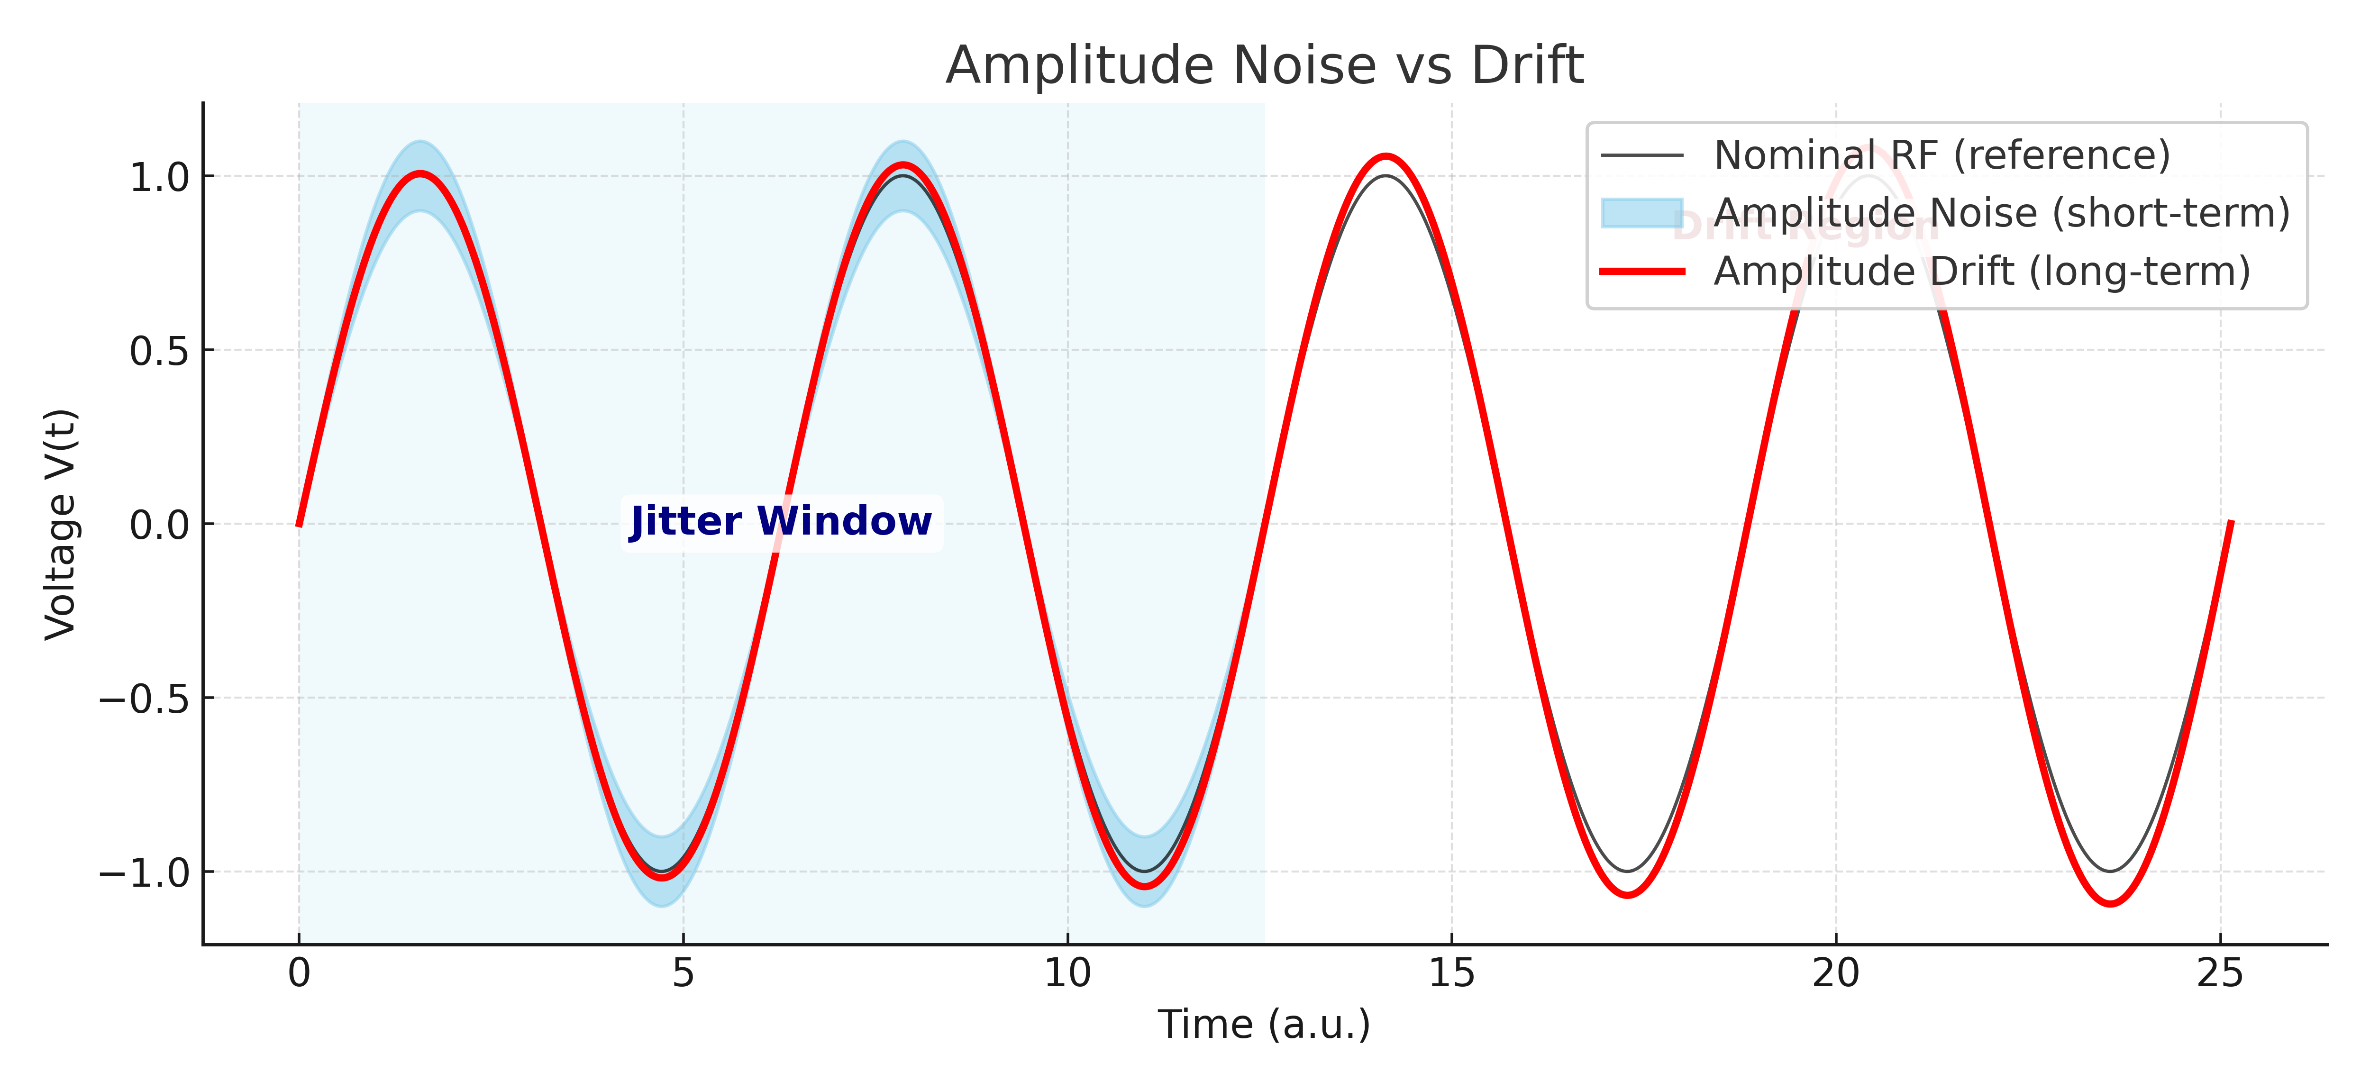
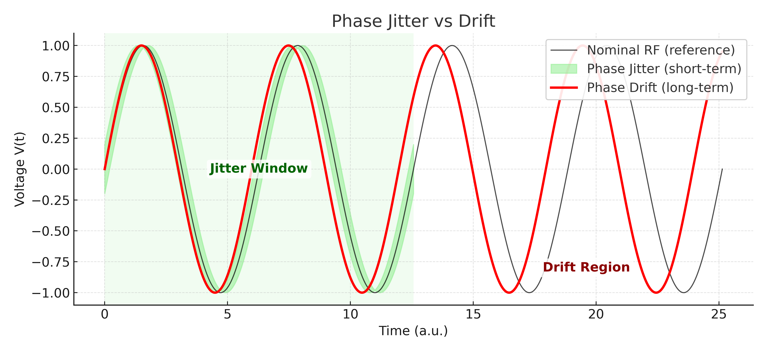
RF Stability Challenges in Linacs and the Role of LLRF (I)
Stability of RF fields is key for beam quality and reproducibility.
Two main instabilities:
Jitter → fast pulse-to-pulse fluctuations (ns–µs timescales)
Drifts → slow amplitude/phase changes (minutes–hours, e.g. thermal, power supply, clock)
➡ Both degrade beam stability, synchronization, and FEL/linac performance.
LLRF-Workshop · Virginia, USA · October 15th, 2025
6

Slide 7
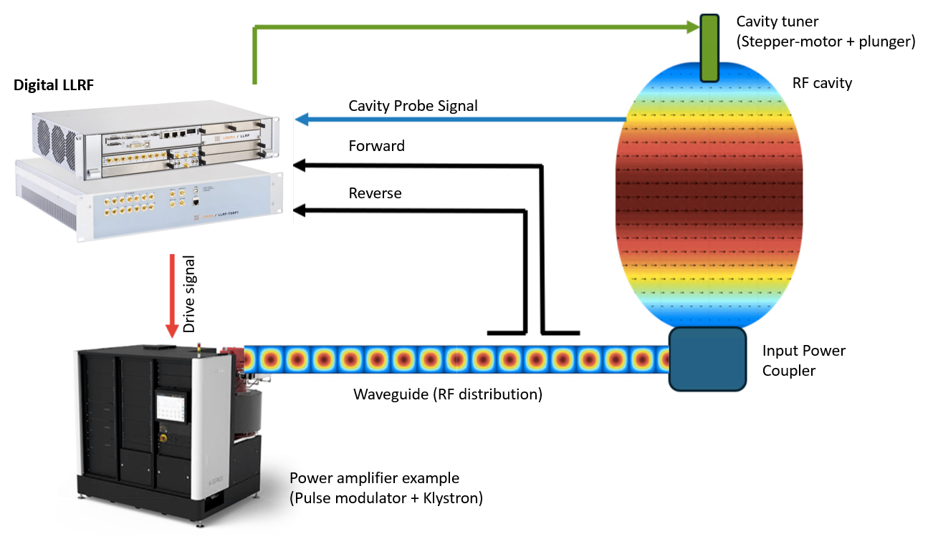
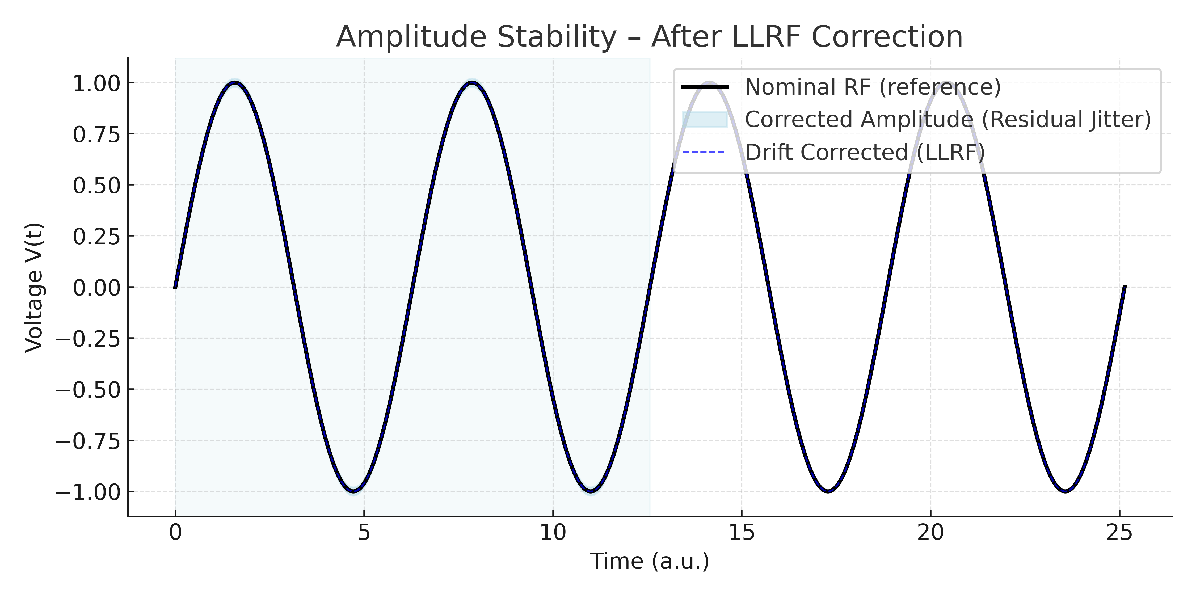
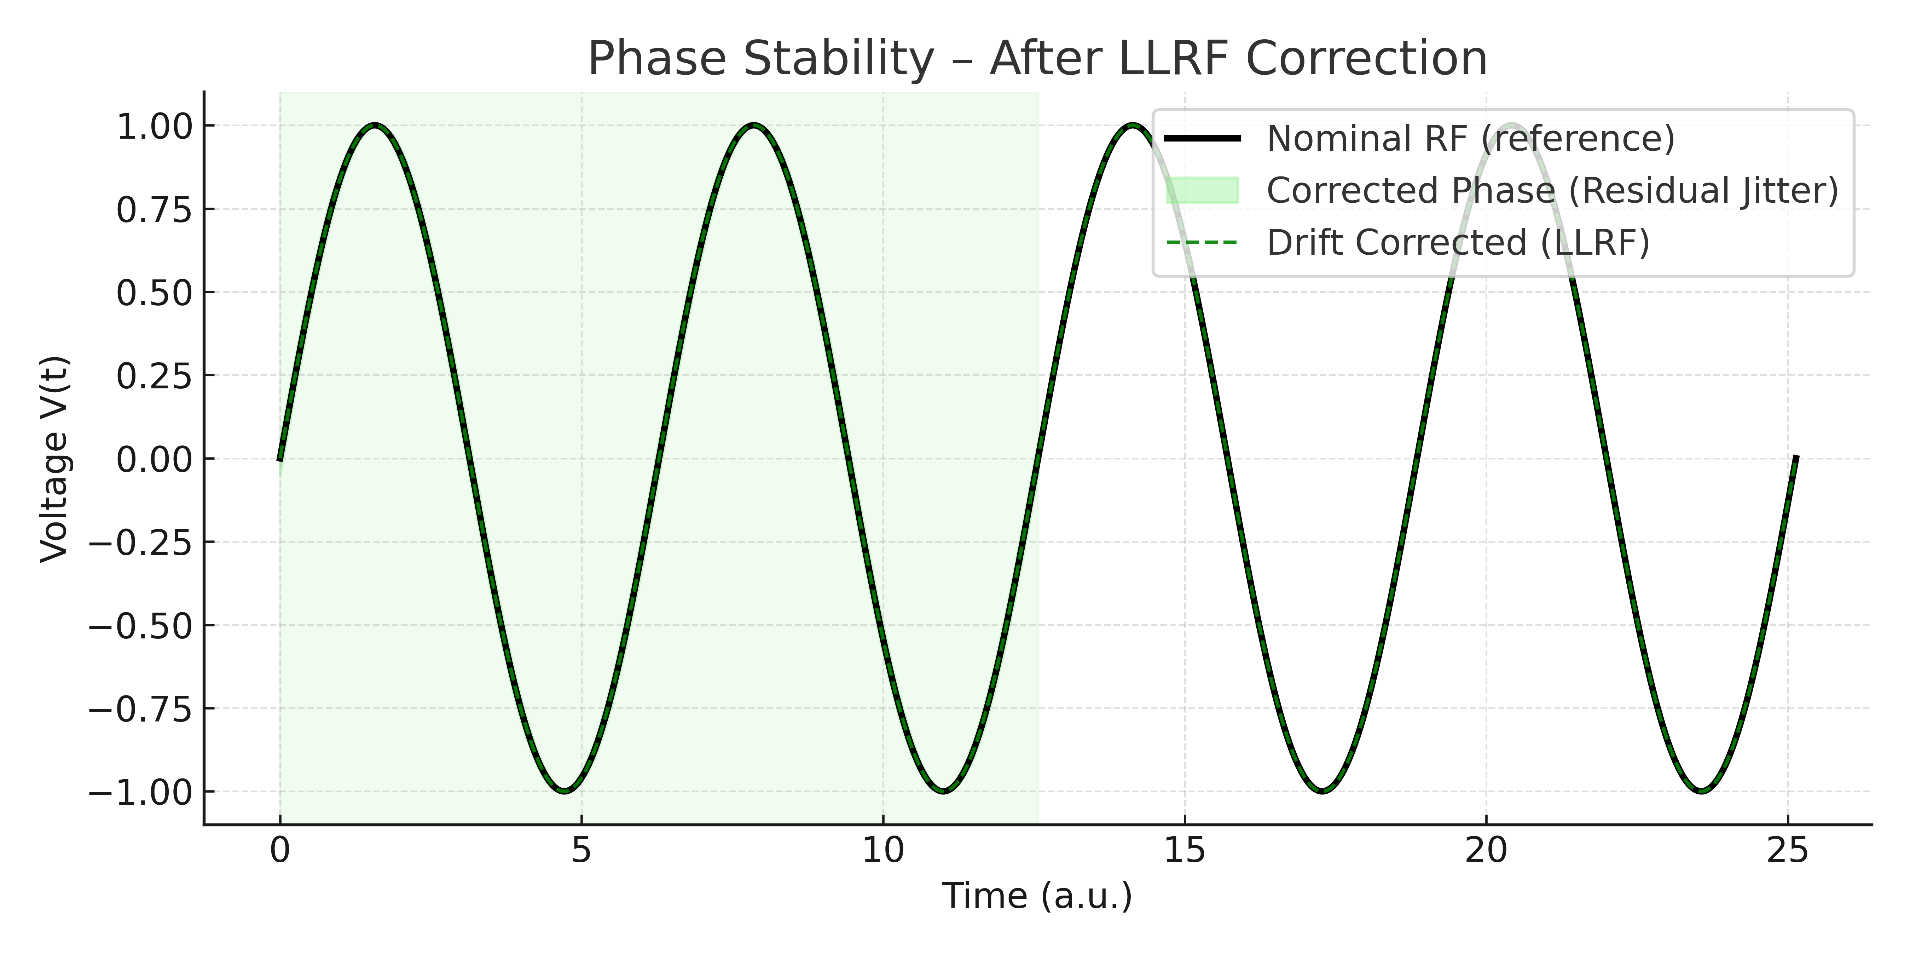
RF Stability Challenges in Linacs and the Role of LLRF (II)
Maintain stability and control of cavity‘s frequency, phase and amplitude.
LLRF continuously measures the characteristics of the RF field in the RF structures and calculates its amplitude and phase of the signal.
Correct short-term jitter through intra-pulse feedback setup.
Compensate long-term drifts via reference synchronization & temperature control.
LLRF-Workshop · Virginia, USA · October 15th, 2025
7

Slide 8
Prototype Requirements
Parameter | Prototype Requirements
Mode of operation | Pulsed
LLRF Frequency | 11.9942 GHz
MO input level | 0 dBm
Nominal Pulse length | 1.55us
Averaging window | final 0.15 us of the RF pulse
Back-end risetime | < 20 ns
Back-end output level | > +10 dBm
Front-end BW | > 20 MHz
Front-end max. input level | +10 dBm
Sampling rate | >230 MHz
RF pulse max. repetition rate | ≥ 400 Hz
Performance evaluation power range (from full scale) | 3 dB
Minimum pulse-to-pulse detectable amplitude noise (400 pulses) | ≤ 0.015 % RMS
Minimum pulse-to-pulse detectable phase noise (400 pulses) | ≤ 0.015° RMS
Back-end pulse-to-pulse added amplitude noise (400 pulses) | ≤ 0.015 % RMS
Back-end pulse-to-pulse added phase noise (400 pulses) | ≤ 0.015° RMS
Num. RF input channels | 2
Num. RF output channels | 1
VM output improved isolation: LO feedthrough | <-40 dBc
Amplitude and phase pulse to pulse feedback | Open loop Only
Front-End
Back-End
LLRF-Workshop · Virginia, USA · October 15th, 2025
8

Slide 9
Prototype Block Diagram
Proposed approach for the prototype:
Single stage down-conversion
Double stage up-conversion
Open loop prototype (separate front-end and back-end systems)
LO and ADC synthesis
MO 12 GHz
ADC
LO-S
LO-9 GHz
LO-X
MO
12 GHz
ADC
250 MHz
LO-S
3 GHz+IF
9 GHz
LO-X
12 GHz+IF
MO
12 GHz
LO-X
12 GHz+IF
ADC
250 MHz
ADC
250 MHz
ADC
250 MHz
LO-S
3 GHz+IF
ADC
&
FPGA
Back-end
FPGA
IQ modulator
9 GHz
RF front-end channel
DAC
RF in1
RF front-end channel
MOD
Drive
12 GHz
RF in2
DAC
RF front-end channel
Front-End
Back-End
LLRF-Workshop · Virginia, USA · October 15th, 2025
9

Slide 10
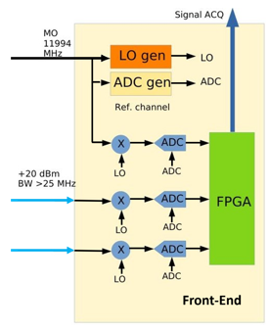
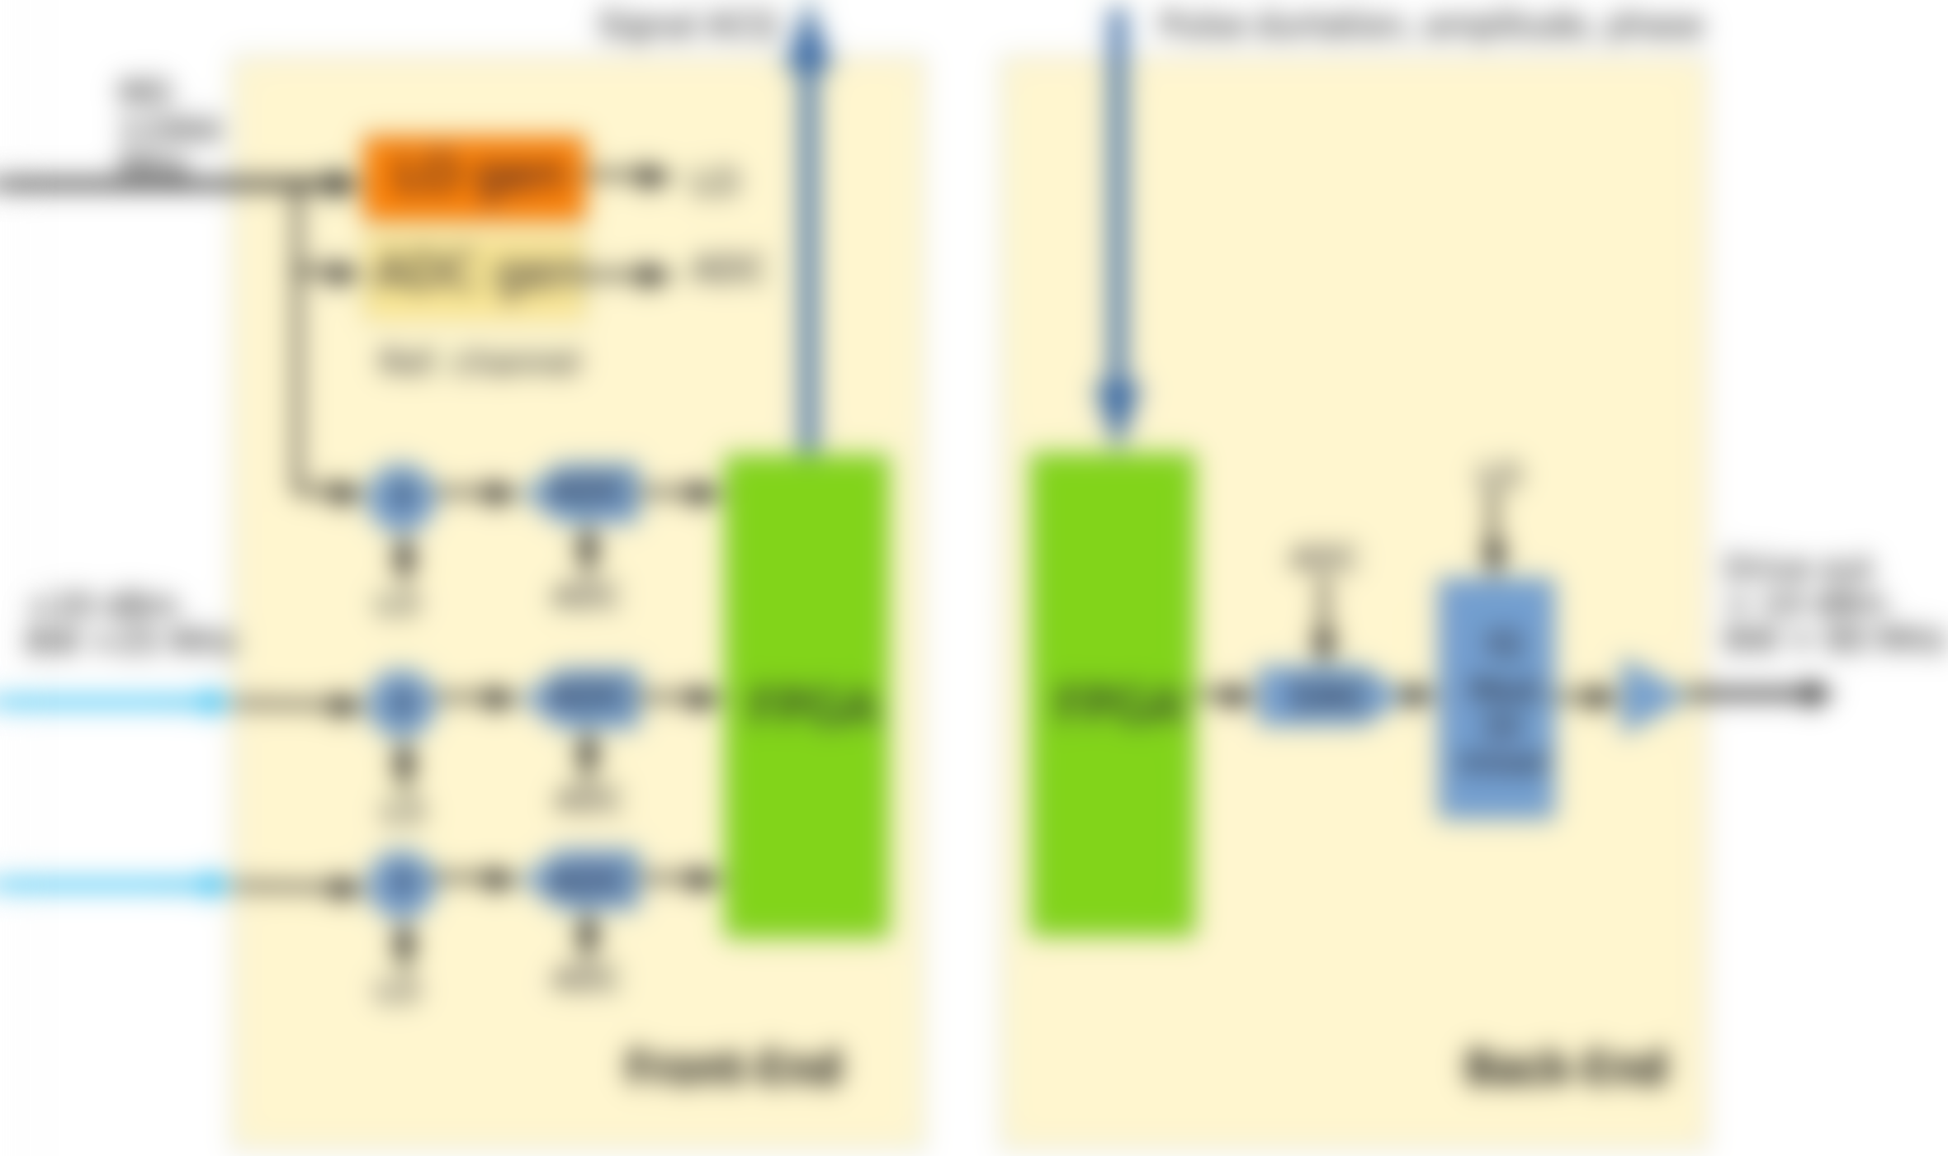
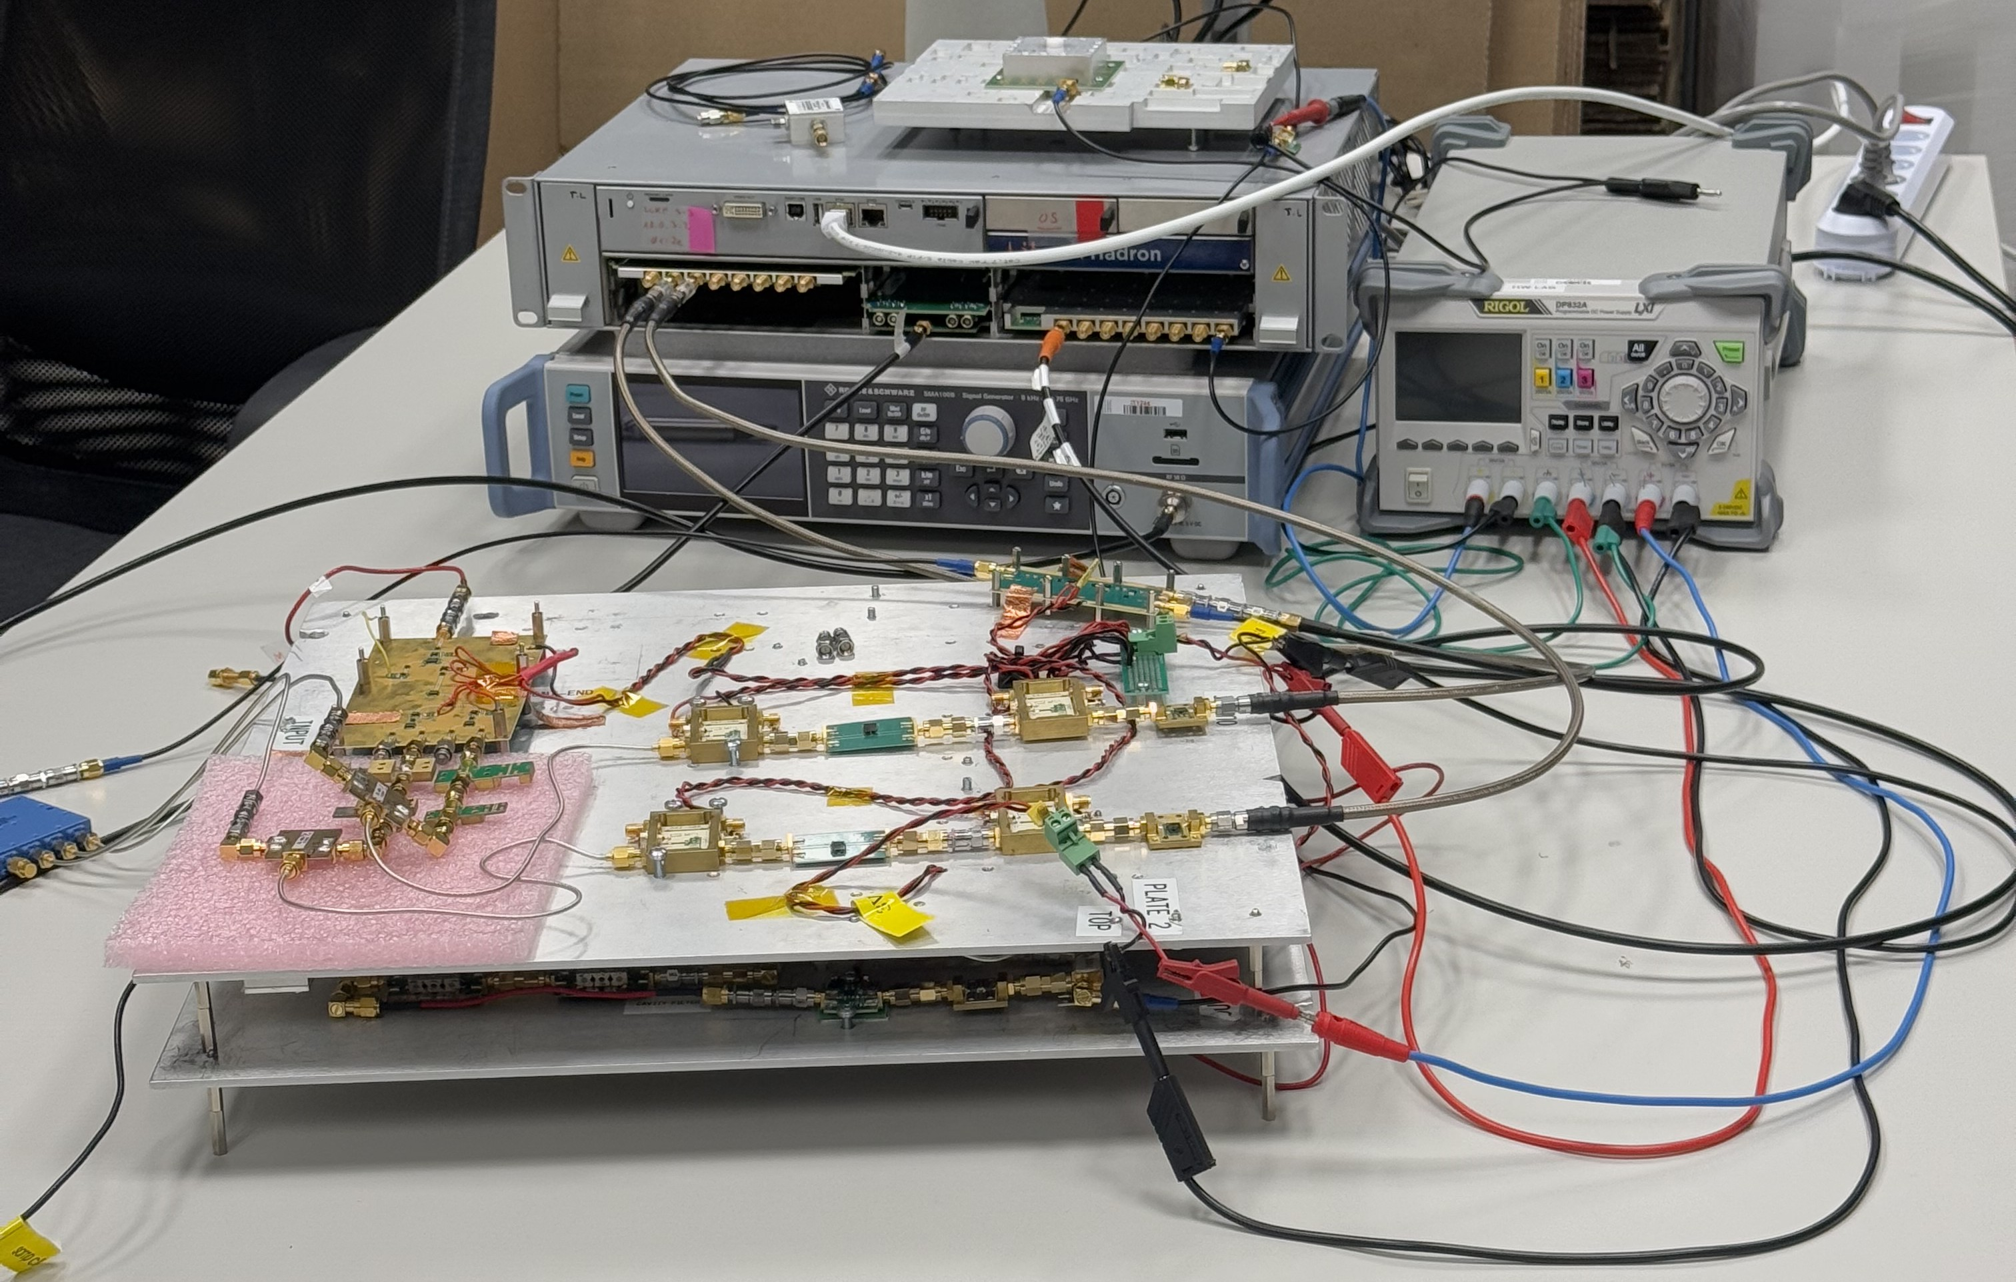
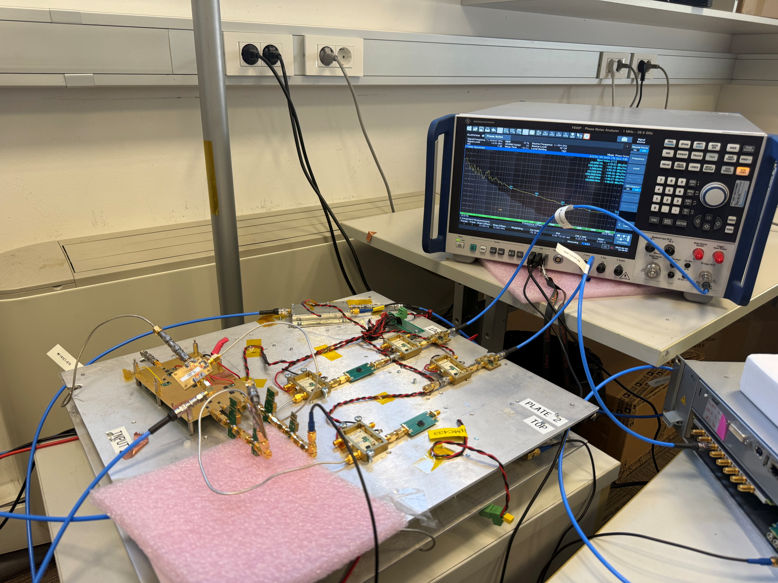
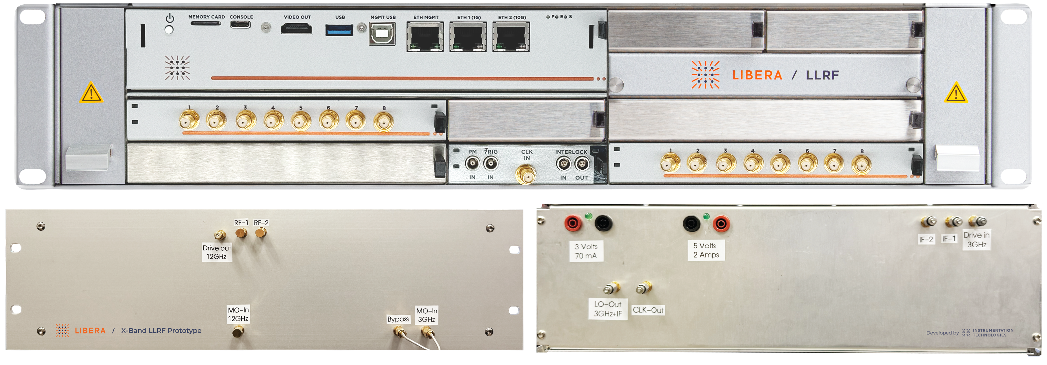
Prototype Development (I)
Phase 1:
Development and assembly of the RF components (frequency conversion (FE and BE), LO and sampling clock generation and distribution)
New 8-ch ADC module designed & developed to support 250 MSps, with sampling clock provided from the RF components.
RF FE performance evaluation as offline processing of raw ADC data (standard deviation of 400 acquired slices of 150 ns)
.
LLRF-Workshop · Virginia, USA · October 15th, 2025
10

Slide 11
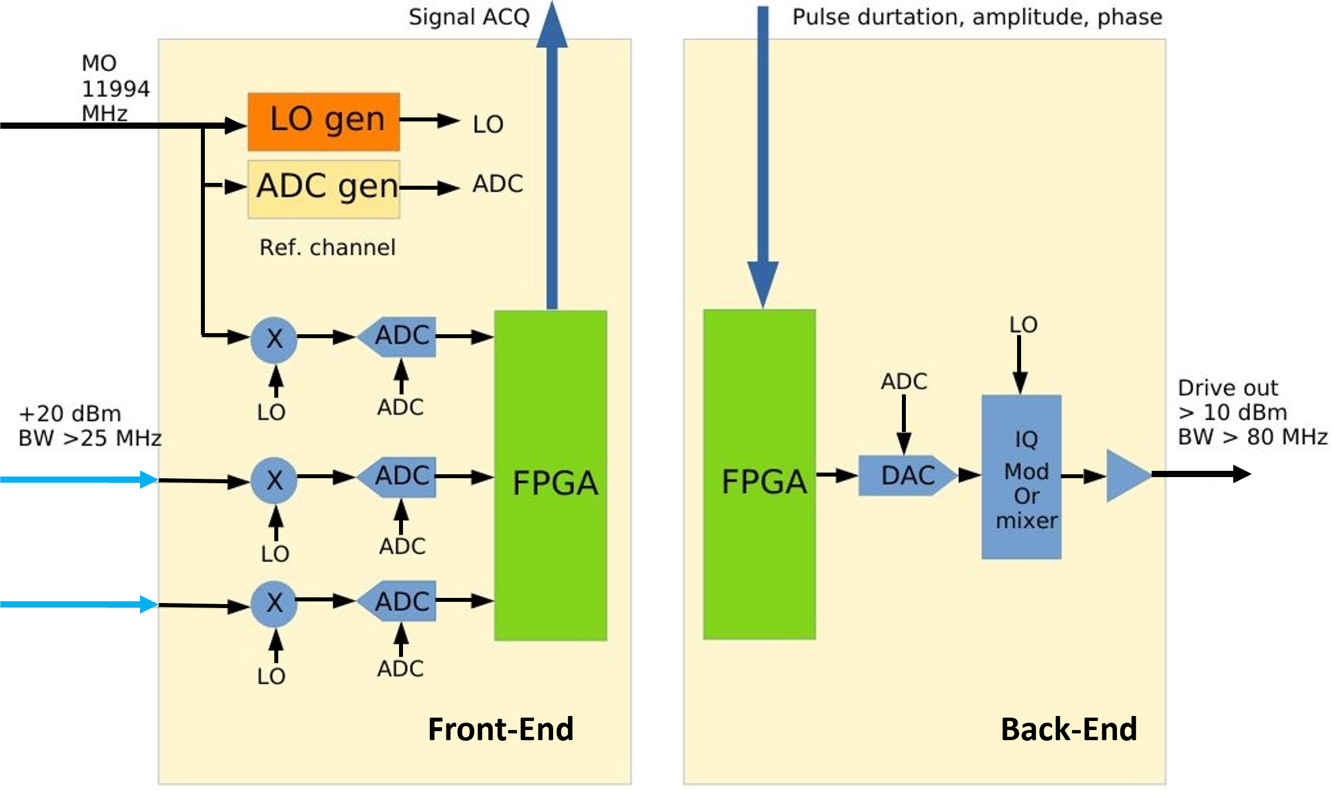
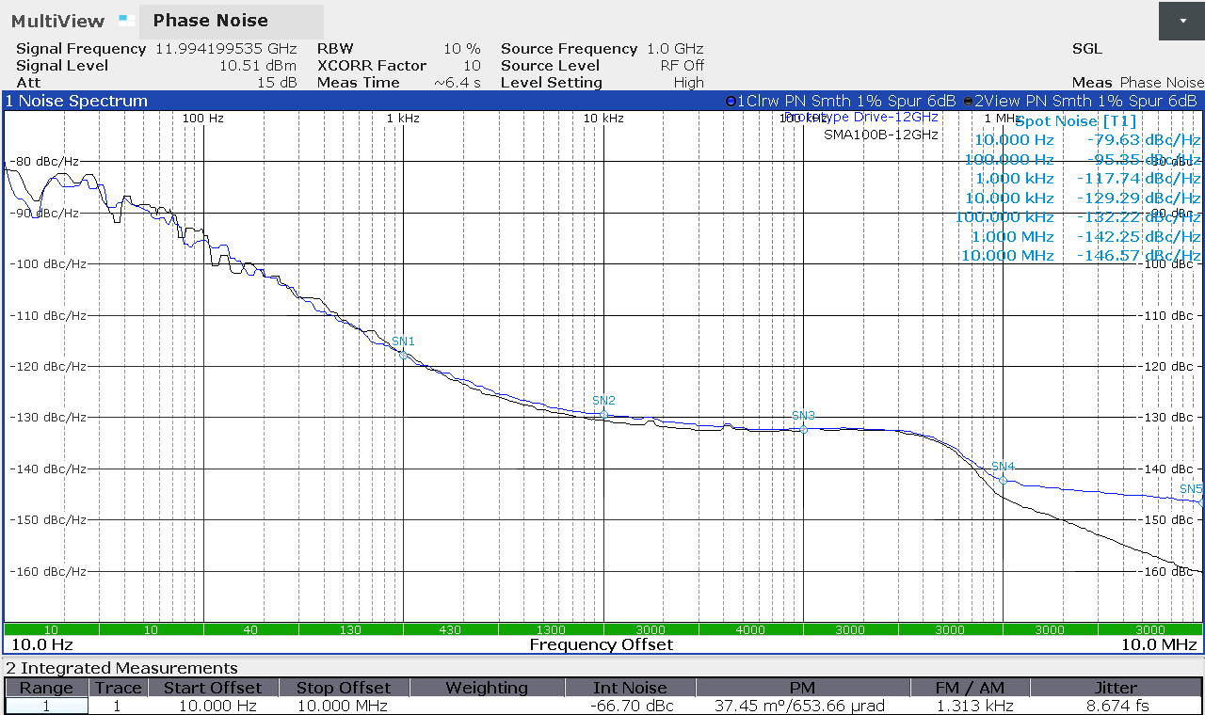
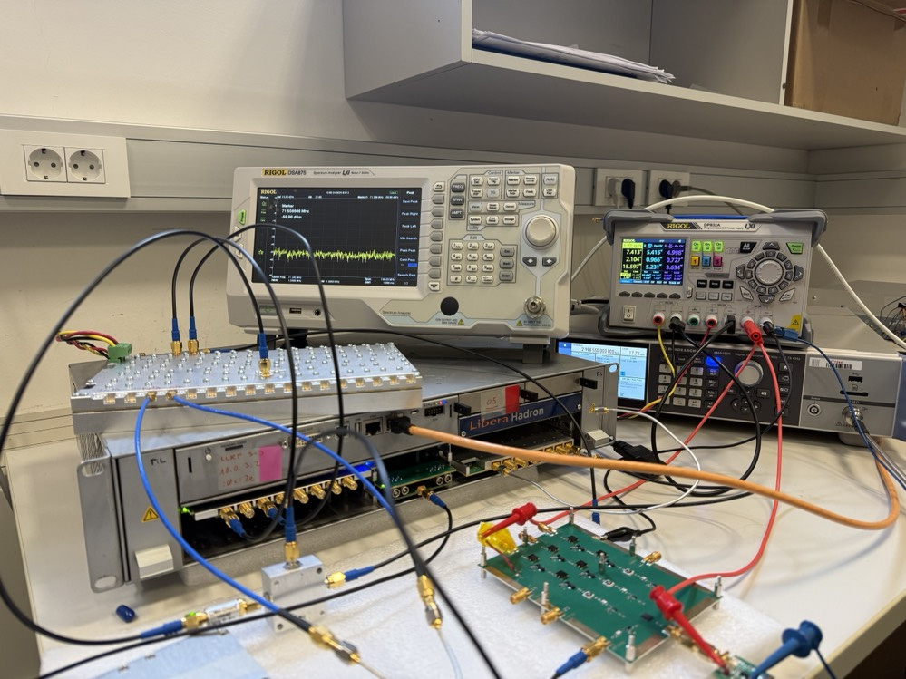
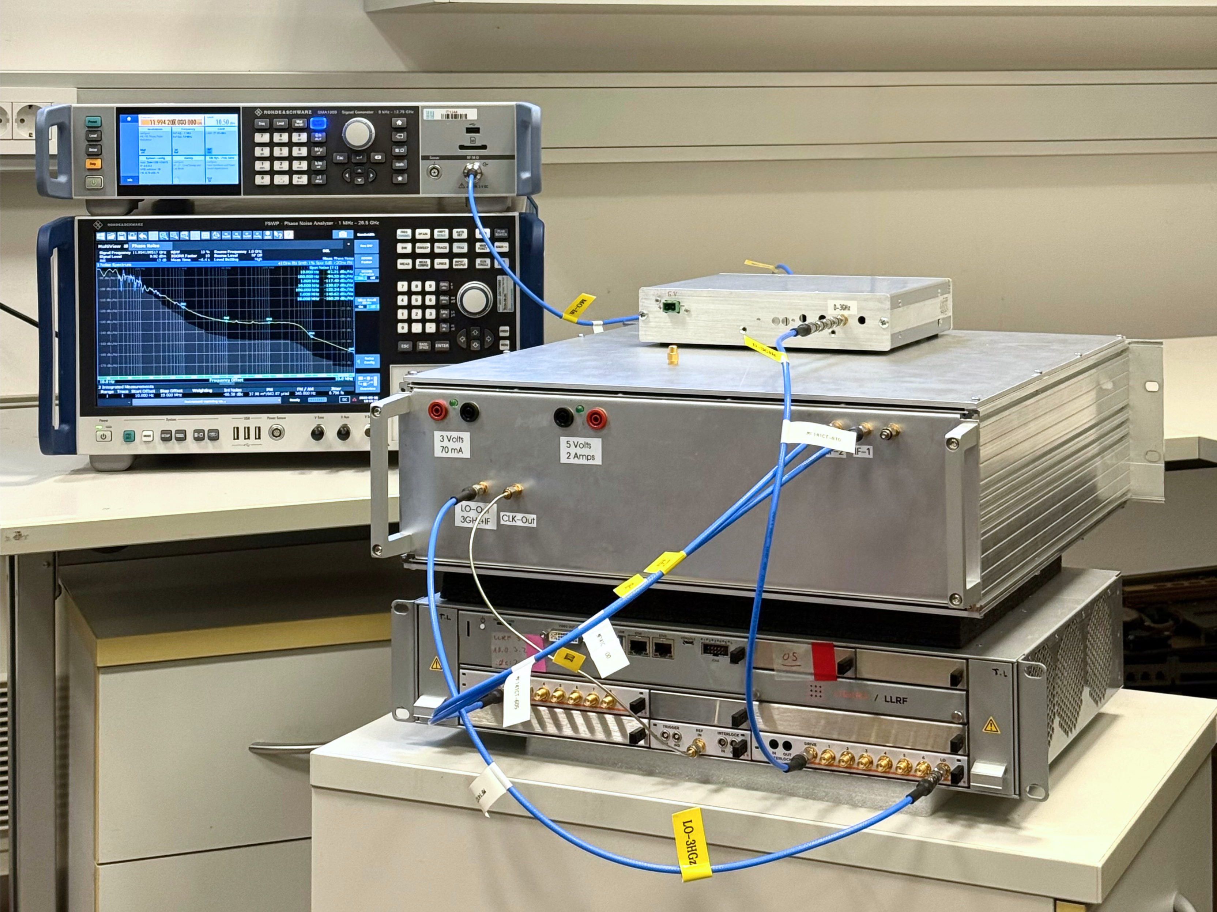
Prototype Development (II)
Phase 2:
RF BE assembly from internally developed boards including FPGA, DAC, IQ modulation.
Integration of the BE within the X-band up-conversion.
Implementation of simple FPGA logic for rectangular pulse generation on trigger (configurable pulse duration amplitude and phase)
RF BE performance evaluation as offline processing of raw ADC data (standard deviation of 400 acquired pulses of 150 ns)
.
LLRF-Workshop · Virginia, USA · October 15th, 2025
11

Slide 12
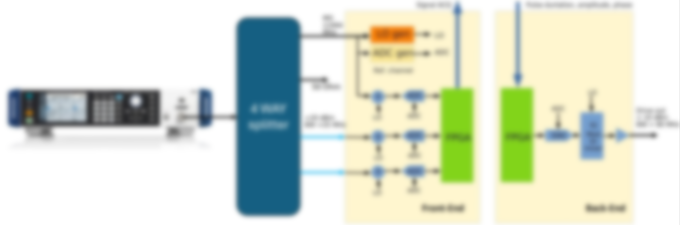
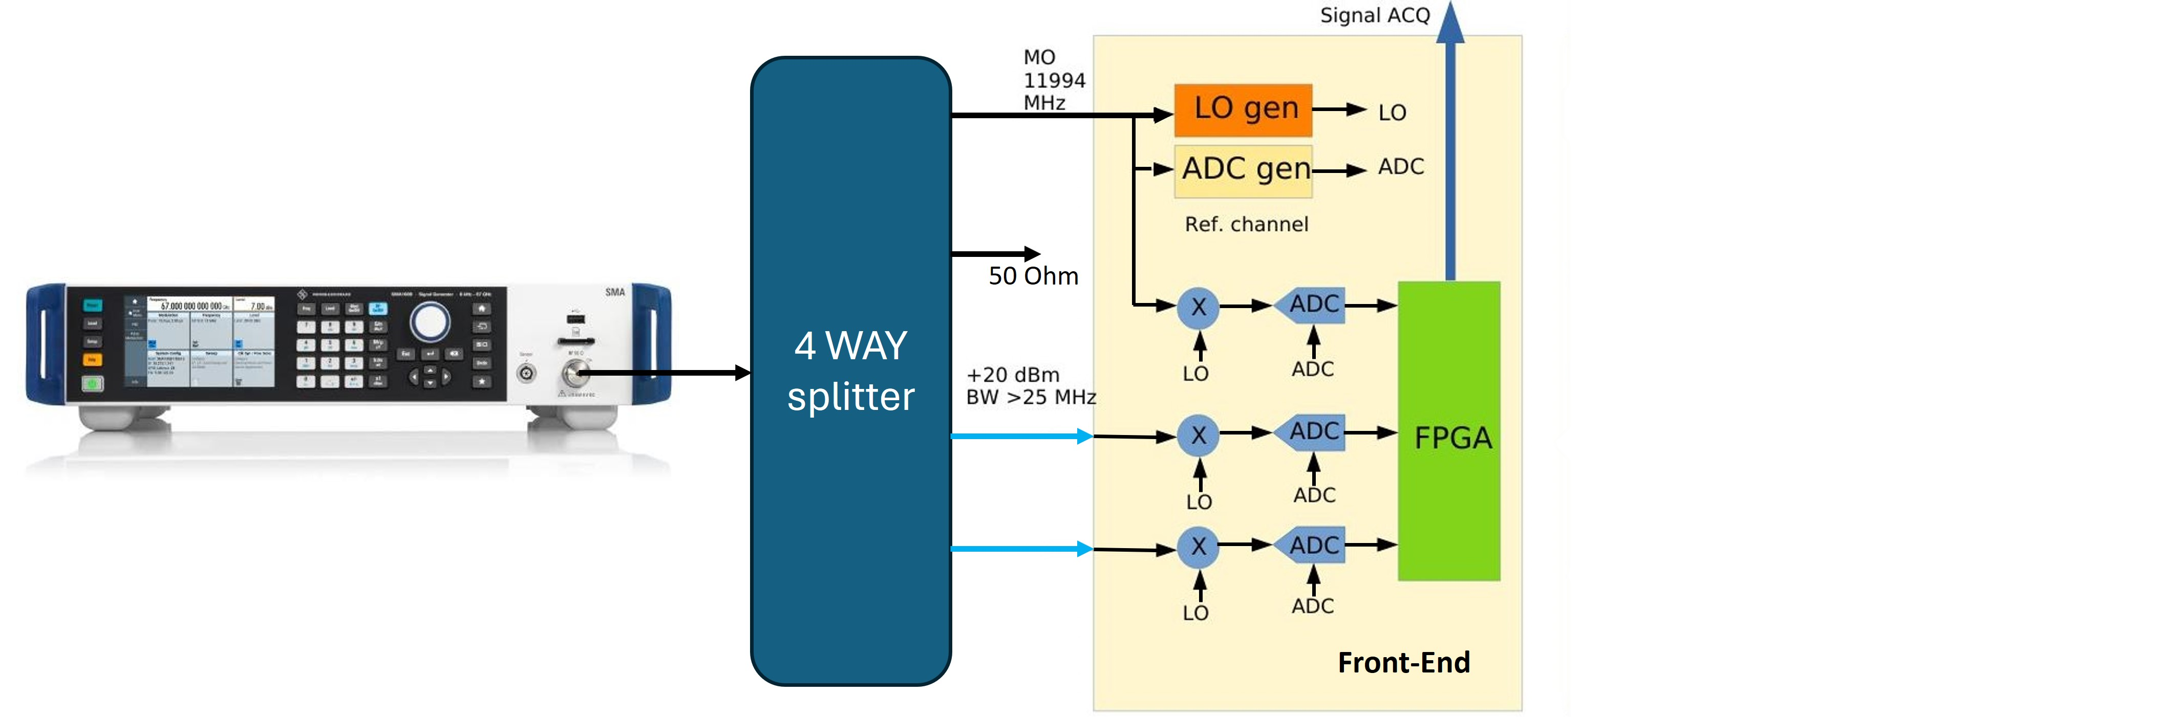
Phase 1 Measurement Setup
A sine wave at 11.994 GHz is applied to two ADC channels
Signal is demodulated and digitized
Amplitude noise and phase jitter is calculated
LLRF-Workshop · Virginia, USA · October 15th, 2025
12

Slide 13
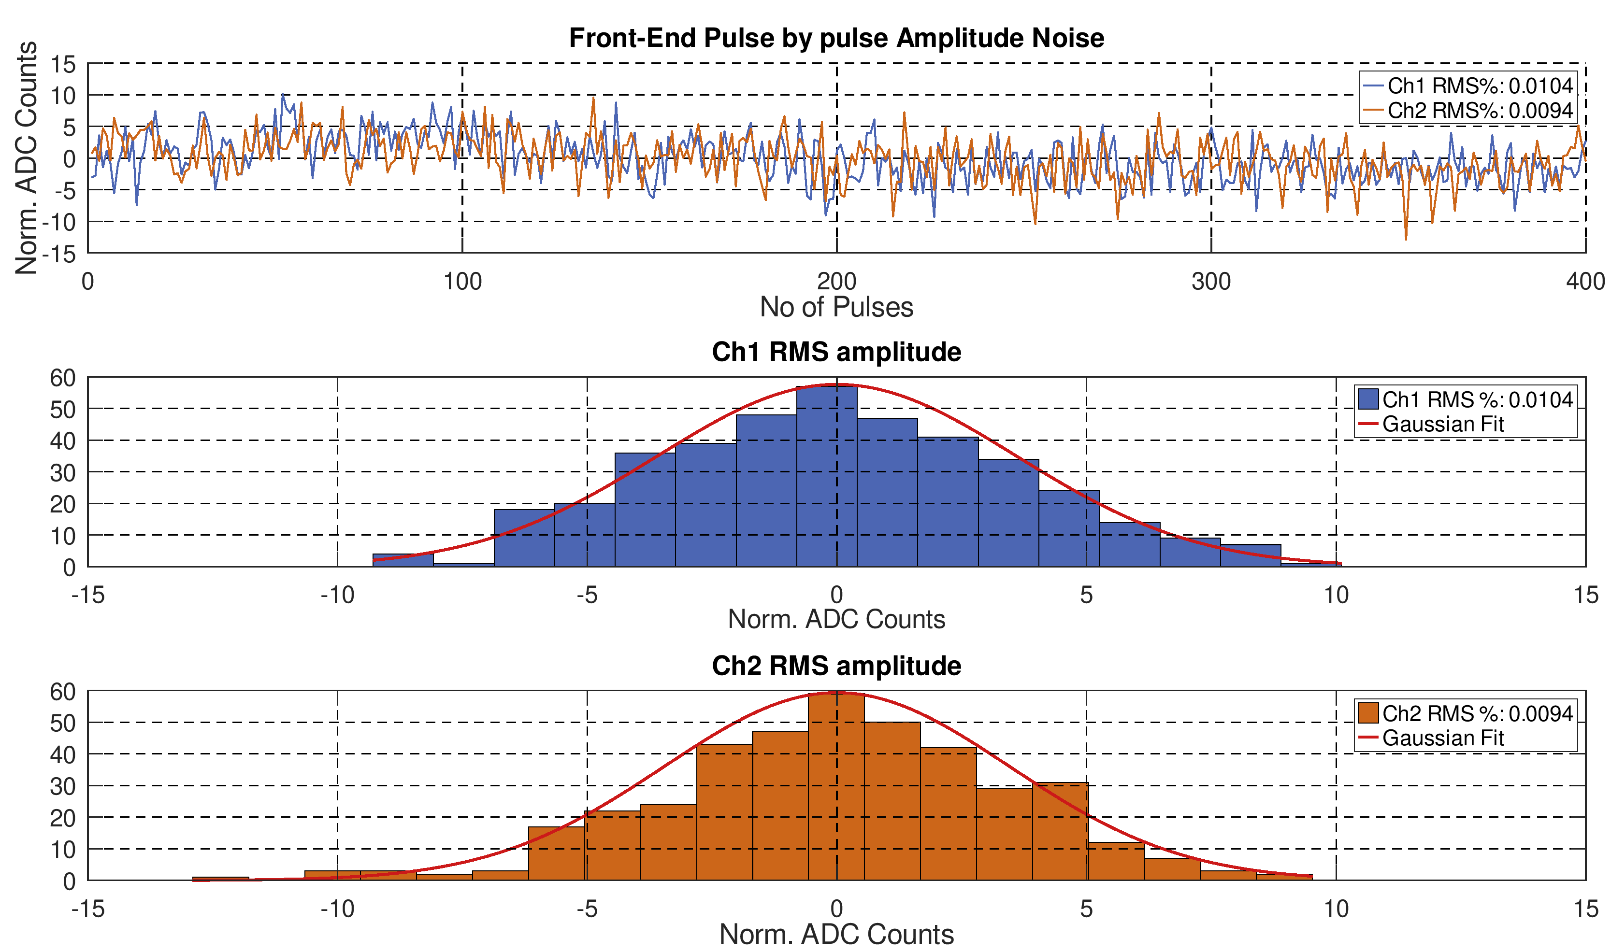
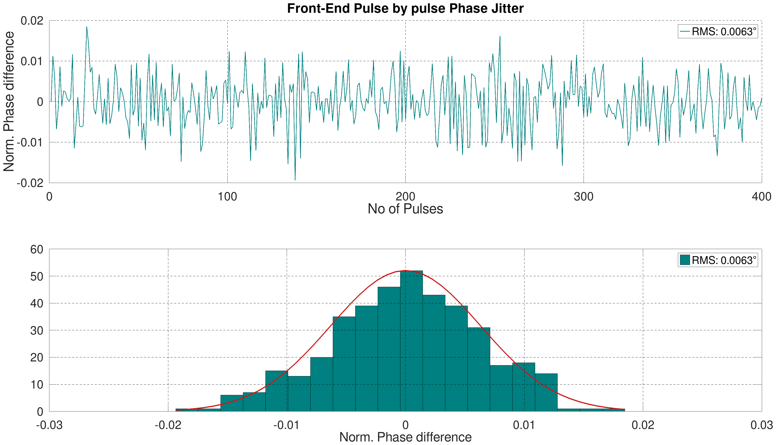
Front-End Performance Results
No of Pulses : 400
Pulse averaging time: 150ns
Sampling rate : 250 MS/s
The LLRF Front-End performance evaluation results are within the EuPRAXIA requirements.
Parameter | Full Scale (ADC Counts) | -3 dB Full Scale (ADC Counts)
Amplitude Noise | 0.010% RMS | 0.011% RMS
Phase Noise | 0.006° RMS (1.39 fs) | 0.0085° RMS
LLRF-Workshop · Virginia, USA · October 15th, 2025
13

Slide 14
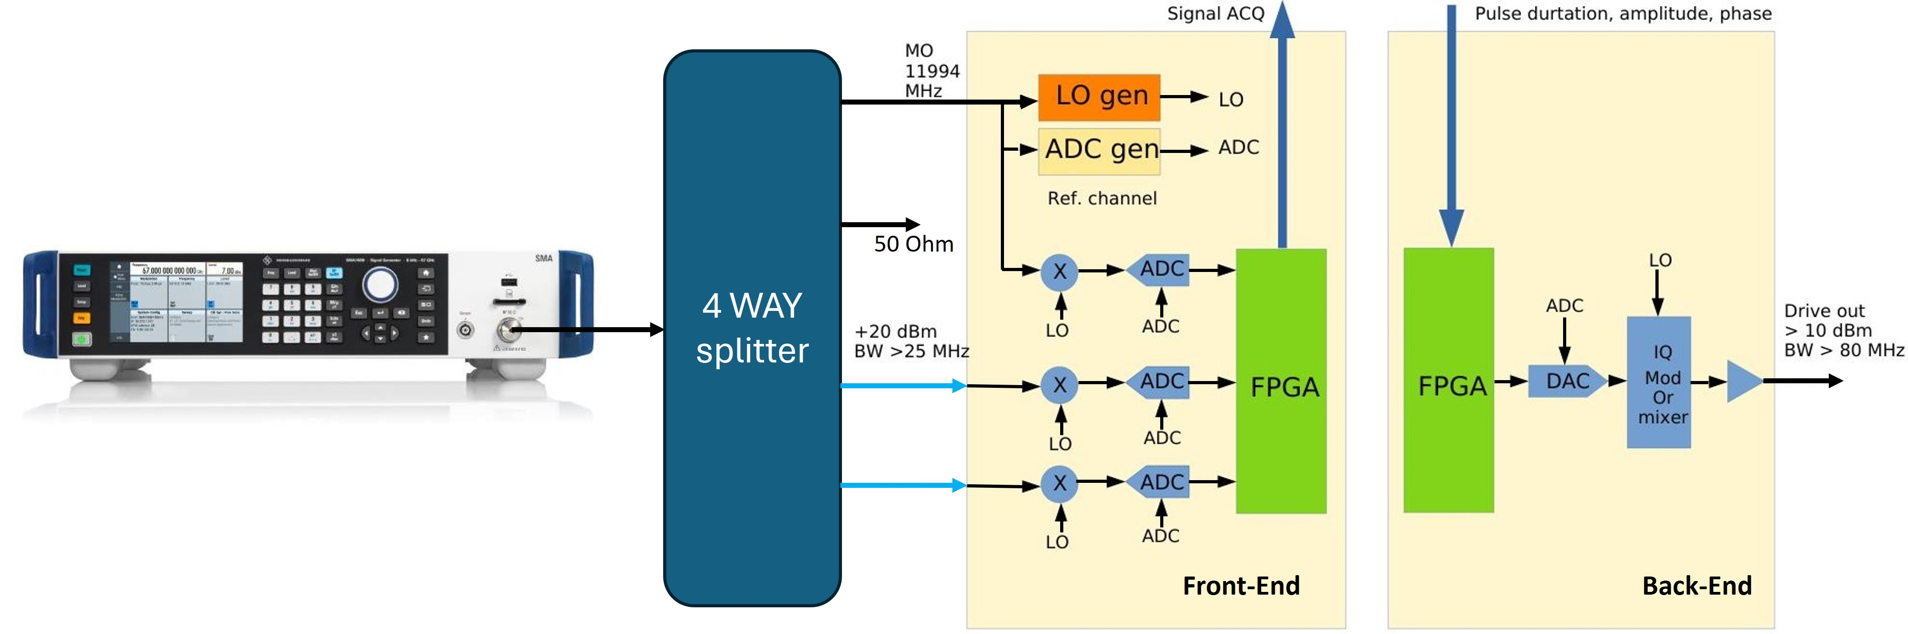
Phase 2 Measurement Setup
KADC module 250 MSps
Pulsed BE 11.994 GHz is applied to one FE down-conversion channel.
Signal is demodulated and digitized
Amplitude noise and phase jitter is calculated
LLRF-Workshop · Virginia, USA · October 15th, 2025
14

Slide 15
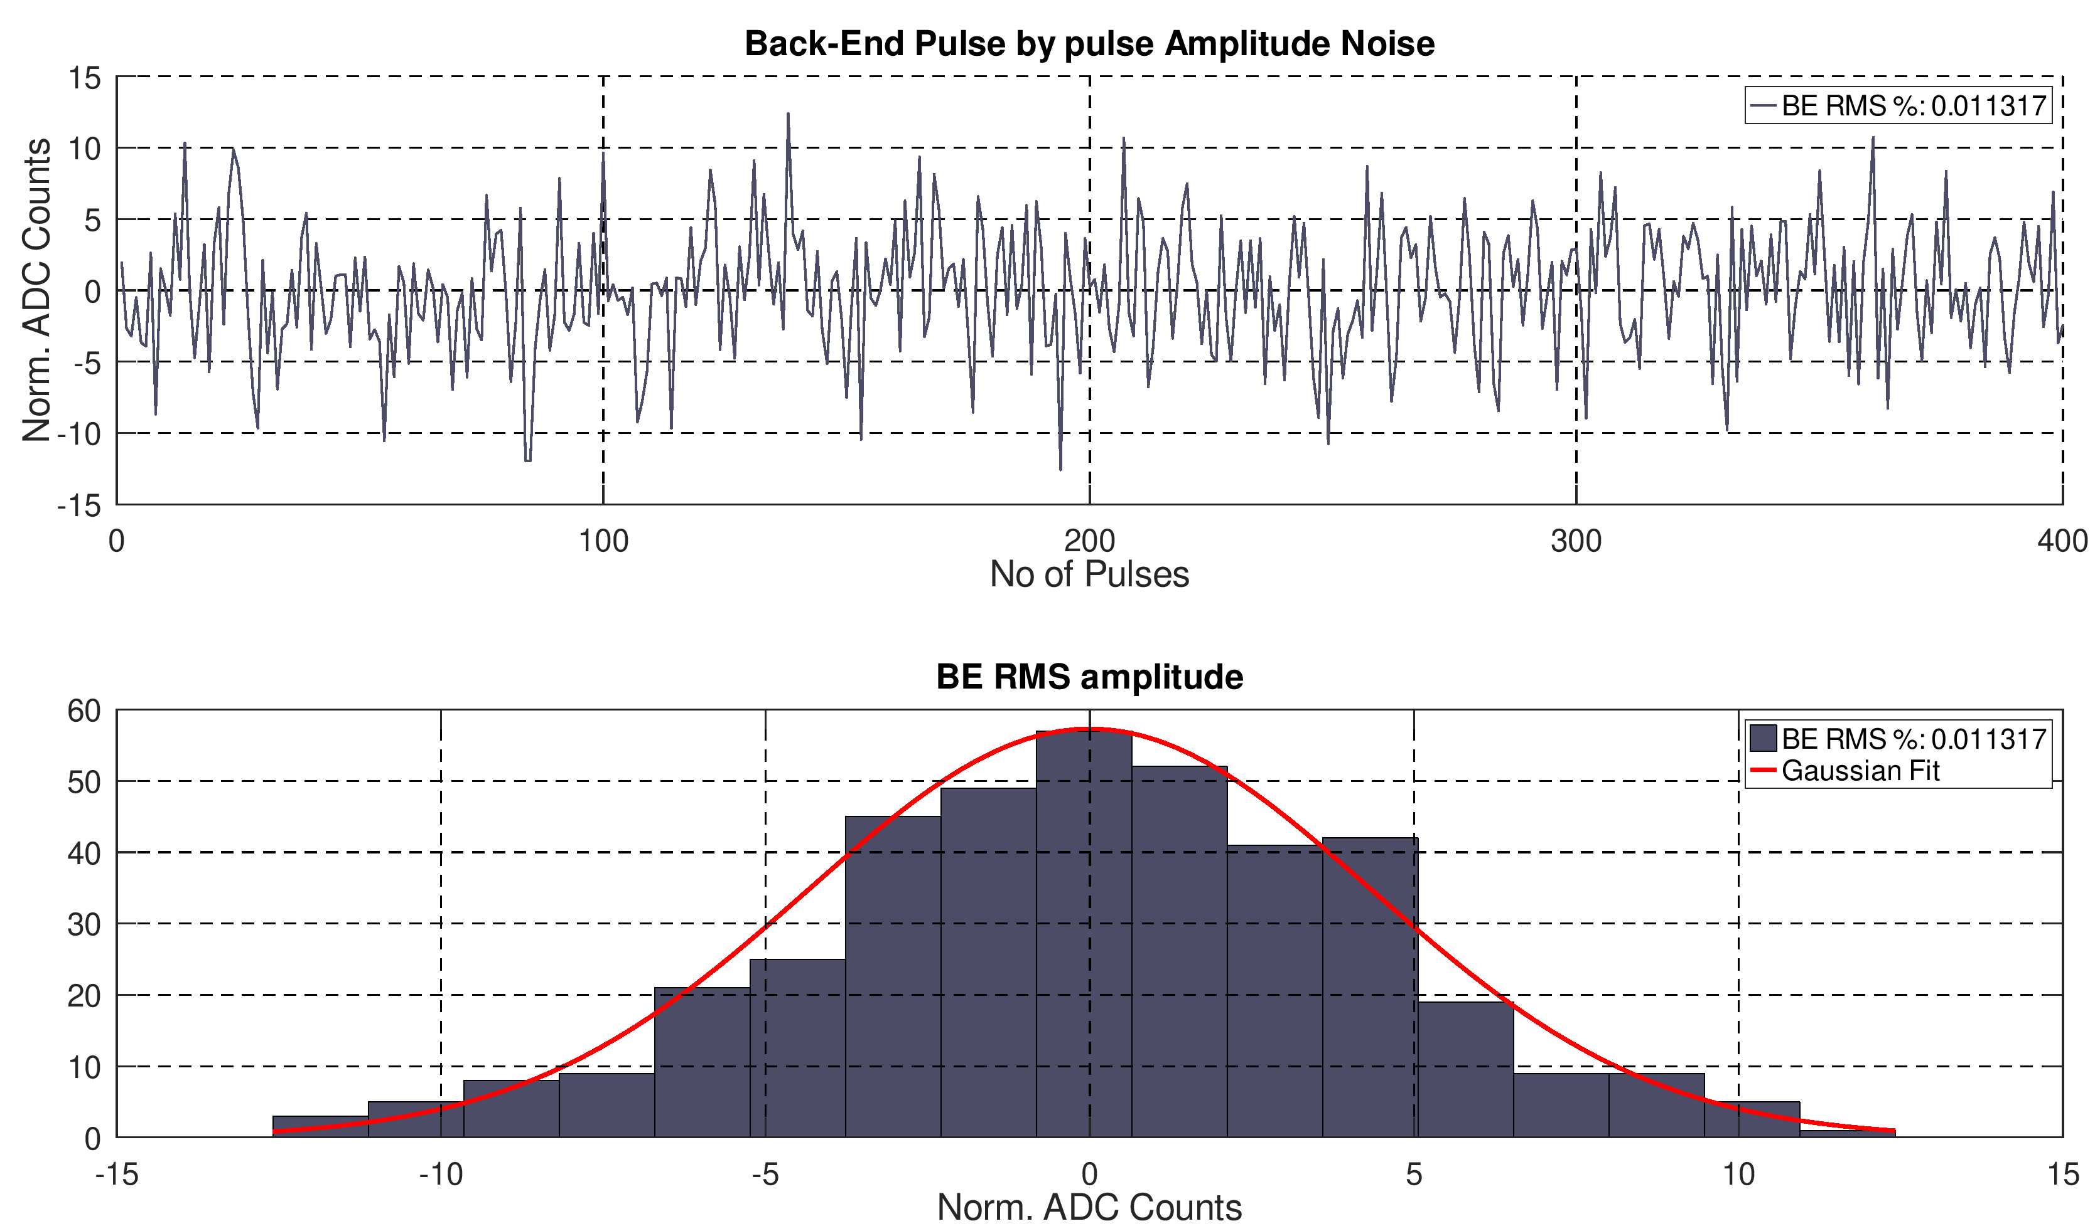
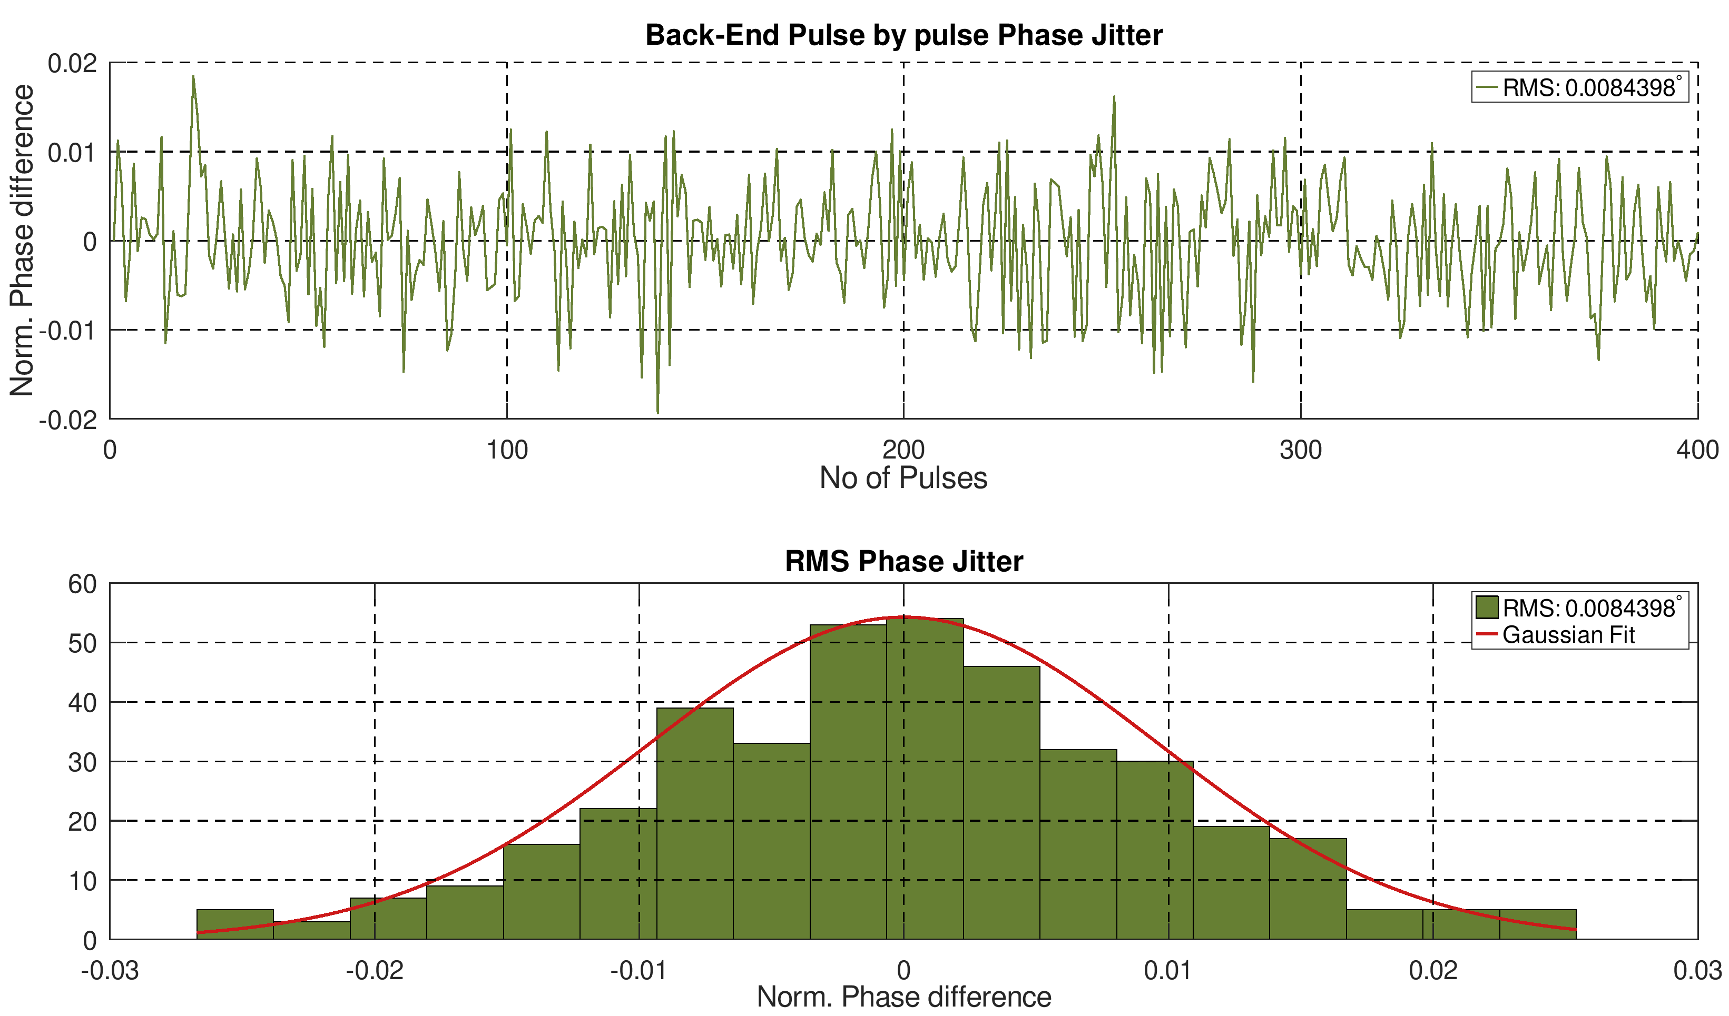
Back-End Performance Results
Parameter | Full Scale (ADC Counts) | -3 dB Full Scale (ADC Counts)
Amplitude Noise | 0.011% RMS | 0.0124% RMS
Phase Noise | 0.0084° RMS (1.95 fs) | 0.0010° RMS
No of Pulses : 400
Pulse averaging time: 150ns
Sampling rate : 250 MS/s
The LLRF Back-End performance evaluation results are within the EuPRAXIA requirements.
LLRF-Workshop · Virginia, USA · October 15th, 2025
15

Slide 16
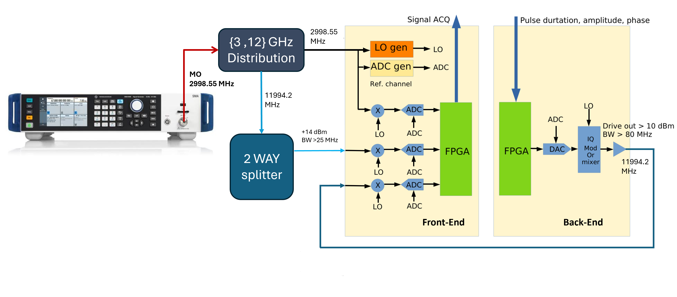
X-Band LLRF prototype with 3 GHz MO (Optional)
LLRF-Workshop · Virginia, USA · October 15th, 2025
16

Slide 17
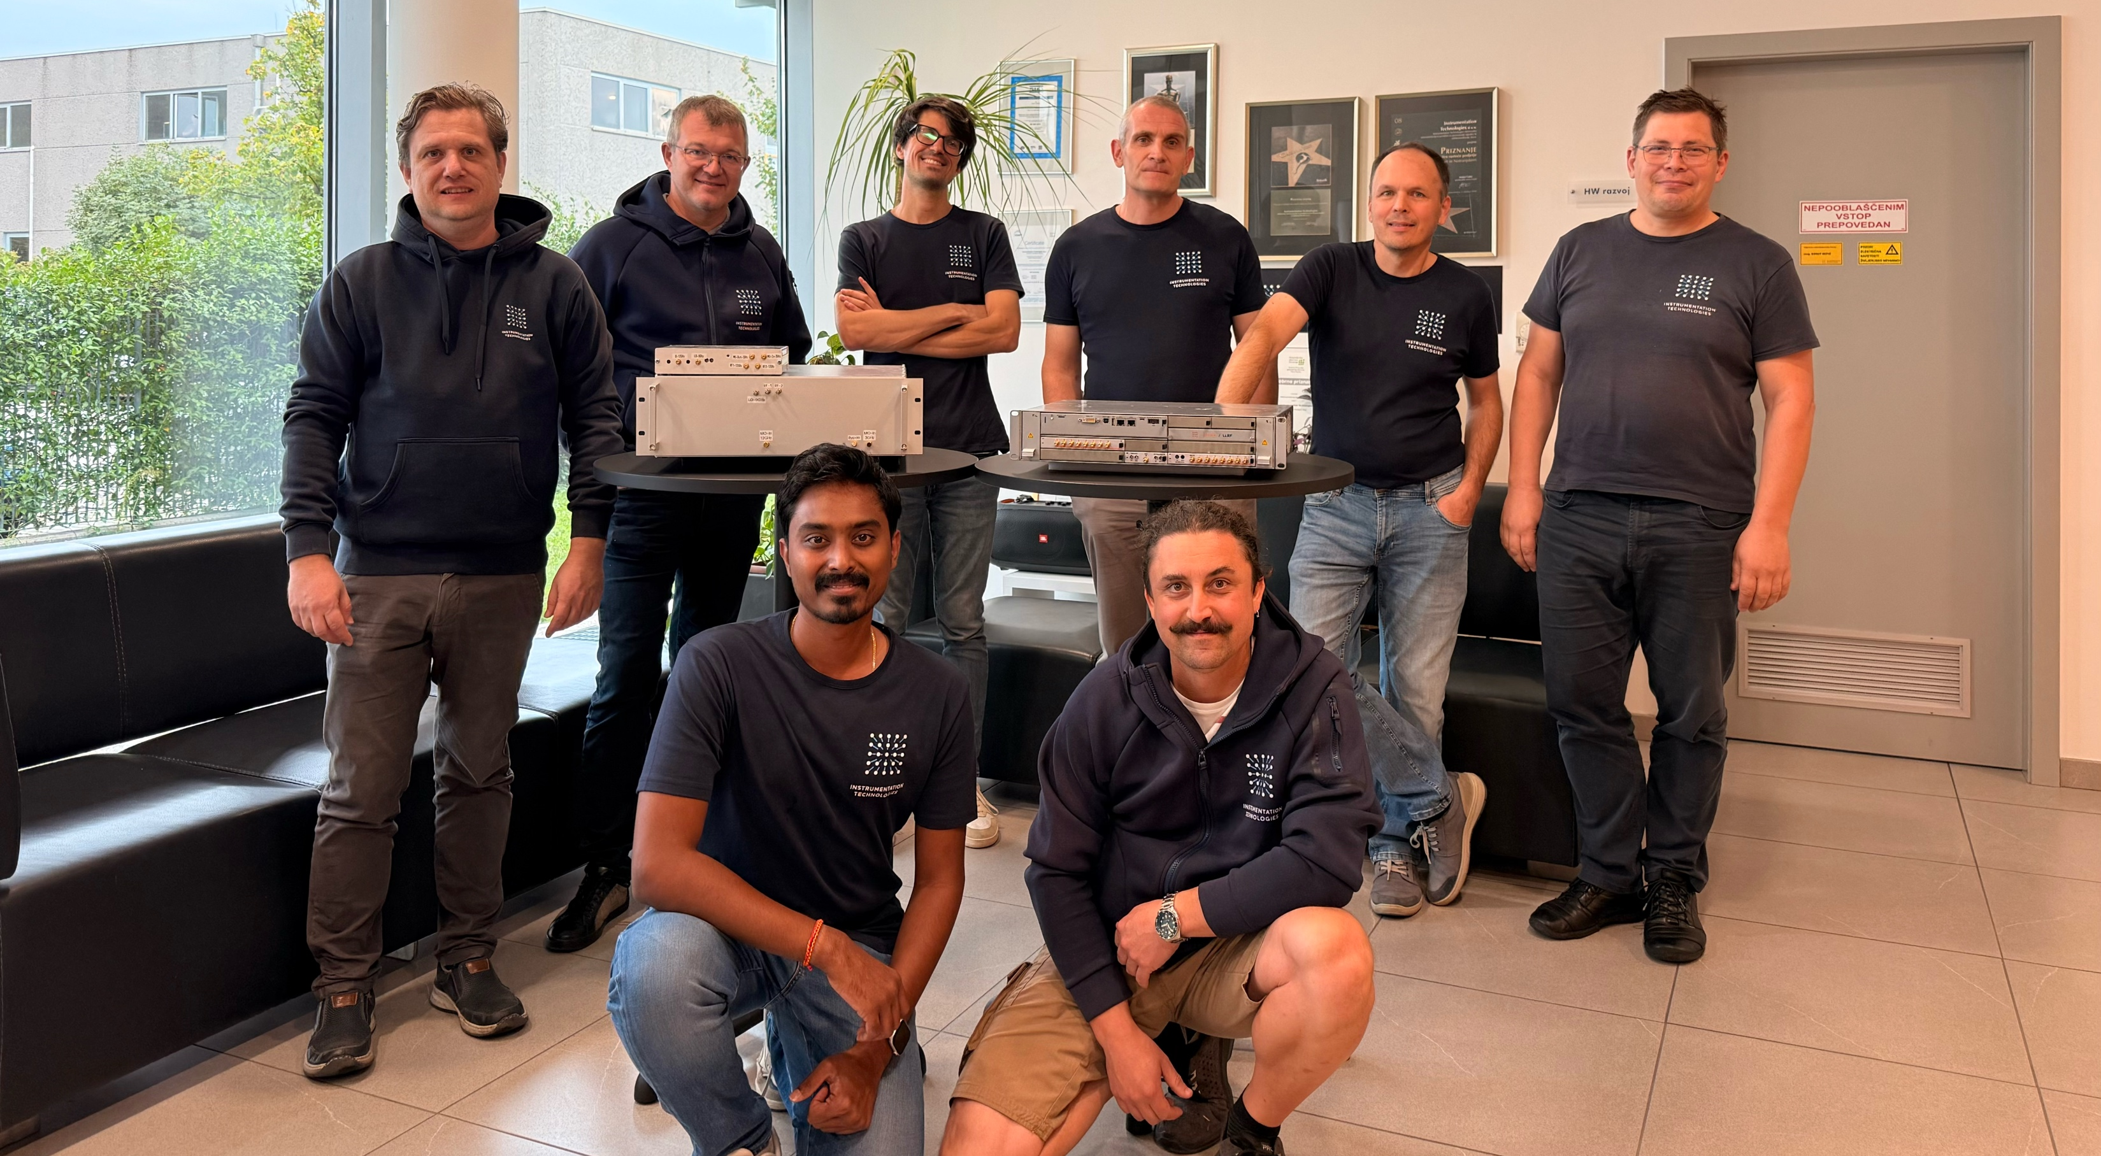

Conclusions & Outlook
X-Band LLRF protoype developed & assembled in the chassis.
KADC8 250 MSps digitizer module produced and verified.
Pulse by Pulse Amplitude and Phase Jitter within EuPRAXIA@SPARC_LAB X-Band LINAC requirements.
Back-End Phase jitter <2 fs for the 12 GHz drive signal.
Next step: Evaluation on an X-band test bench at the TEX facility, INFN-LNF, Frascati, Italy in Novemeber, 2025.
Scan for more information about Libera LLRF.
Thank you!
Many thanks to HW, SW, FPGA colleagues at I-TECH.
Special Thanks to RF group at TEX facility, INFN-LNF.
LLRF-Workshop · Virginia, USA · October 15th, 2025
17

Slide 18
Backup slides
LLRF-Workshop · Virginia, USA · October 15th, 2025
18

Slide 19
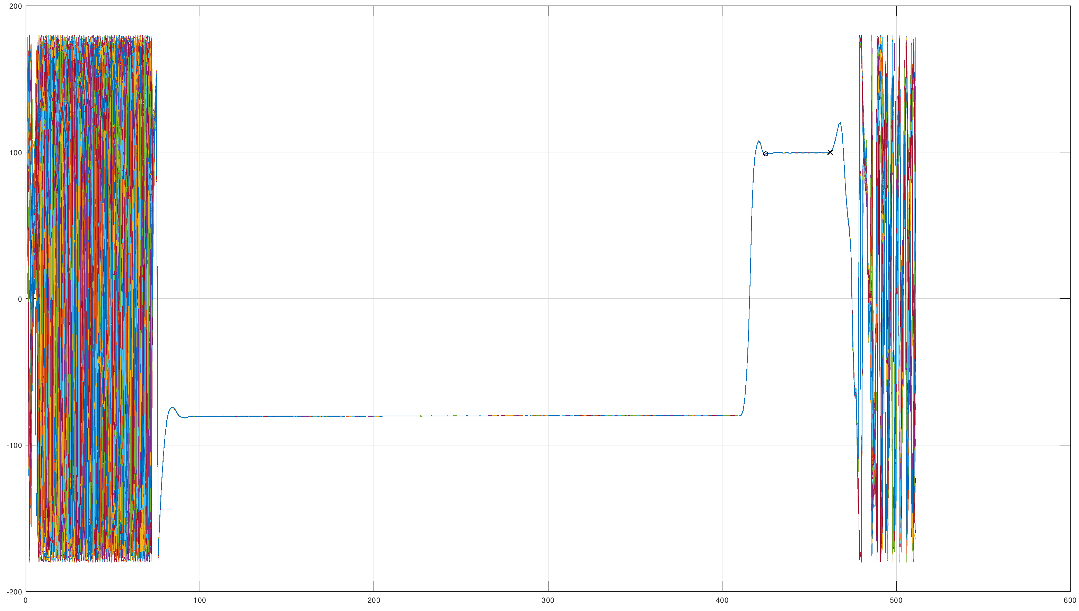
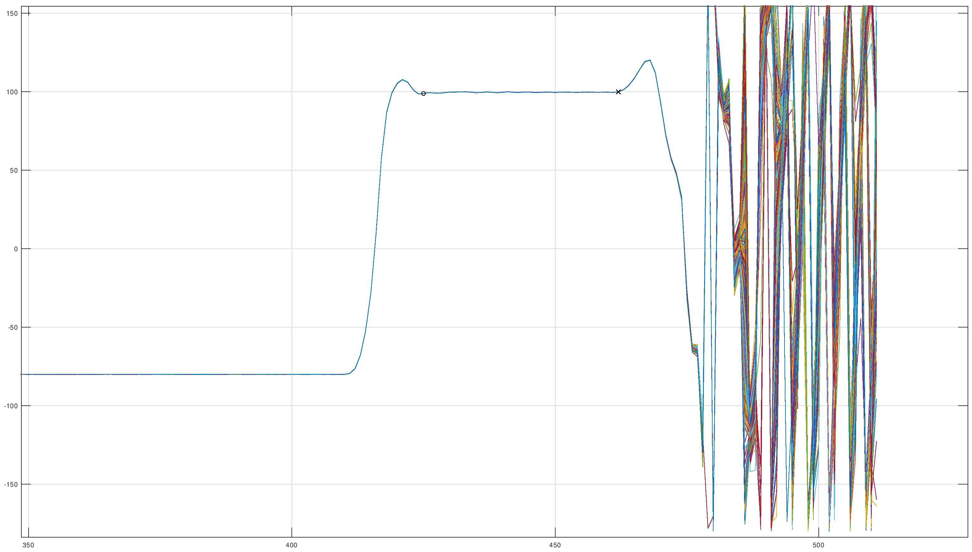
Back-End Phase analysis
150 ns Pulse Processing
180° Phase shift
52 ns including 17 ns Rise time
1.55 µs Pulse duration
Rise time : 17 ns
LLRF-Workshop · Virginia, USA · October 15th, 2025
19

